Slide 1
Lecture 3
CSE 4101
Topic: Knowledge representation: Formalized Symbolic Logic: Syntax and Semantics for Propositional logic

Slide 2
Syntax and Semantics for propositional logic
Propositions are elementary atomic sentences. We shall also use the term formulas or well-formed formulas in place of sentences. Propositions may be either true or false but may take on no other values. Some examples of simple propositions are

Slide 3
Continue
• It is raining
• My car is painted silver
• John and Sue have five children
• Snow is white
• People live on the moon.

Slide 4
Continue
Compound propositions are formed from atomic formulas using the logical connectives ”not”, “and”, “or”, “if...then”, and “if and only if”. For example the following are compound formulas.
It is raining and the wind is blowing.
The moon is made of green cheese or it is not.
If you study hard you will be rewarded.
The sum of 10 and 20 is not 50.

Slide 5
Continue
We will use capital letters, sometimes followed by digits, to stand for propositions: T and F are special symbols having the values true and false, respectively.
The following symbols will also be used for logical connectives
~ for not or negation
& for and or conjunction
V for or or disjunction
→ for if...then or implication
↔ for if and only if or double implication (example)

Slide 6
Continue
In addition left and right parentheses, left and right braces and the period will be used as delimiters for punctuation. For example, to represent the compound sentence “It is raining and the wind is blowing” we could write (R & B) where R and B stand for the proposition “It is raining” and “the wind is blowing” respectively. If we write (RVB) we mean “It is raining or the wind is blowing or both”, that is , V (Disjunction, OR) indicates inclusive disjunction. (Revert V)

Slide 7
Syntax
The syntax of PL is defined recursively as follows.
T and F are formulas.
If P and Q are formulas, the following are formulas:
(∼ P)
(P& (Conjunction)Q)
(P∨Q)
(P→Q)
(P↔ Q)

Slide 8
Continue
All formulas are generated from a finite number of the above equations. An example of a compound formula is Knowledge
((P &(~QVR) → (Q →S))
If there is no chance of ambiguity, we will omit parenthesis,

Slide 9
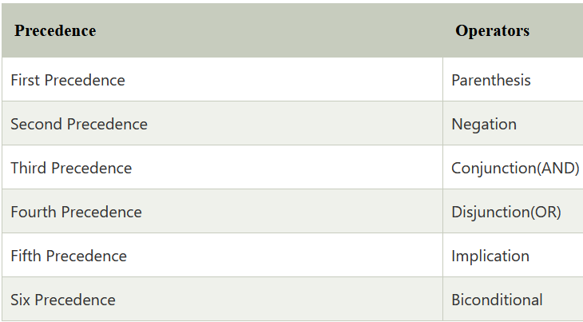
Continue
Just like arithmetic operators, there is a precedence order for propositional connectors or logical operators. This order should be followed while evaluating a propositional problem. Following is the list of the precedence order for operators:

Slide 10
Continue
For better understanding use parenthesis to make sure of the correct interpretations. Such as ¬R∨ Q, It can be interpreted as (¬R) ∨ Q. Also (~(P &(~Q))) can be written as ~(P&~Q).

Slide 11
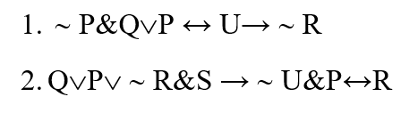
Continue
Given the following PL expressions, place parenthesis in the appropriate places to form fully abbreviated well formed formulas.

Slide 12
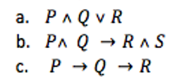
Continue
Fully parenthesis each of the following formulas. That is, add parenthesis so that the structure is determined by the parentheses without the need for the rules of precedence

Slide 13
Semantics
The semantics or meaning of a sentence is just the value true or false; that is, it is an assignment of a truth value to the sentence. The value true and false should not be confused with the symbols T and F which can appear within a sentence.

Slide 14
Semantics-continue- (Home Task)
An interpretation for a sentence or group of sentences is an assignment of a truth value to each propositional symbol. As an example, consider the statement (~P & Q). One interpretation (I1) assigns true to P and false to Q. A different interpretation (I2) assigns true to P and true to Q. Clearly, there are four distinct interpretations for this sentence.

Slide 15
Semantics-continue
Once an interpretation has been given to a statement, its truth value can be determined. This is done by repeated application of semantic rules to larger and larger parts of the statement until a single truth value is determined. The semantic rules are summarized in the table, where t and t´ denote any true statements, f and f´ denote any false statements and a is any statement.

Slide 16
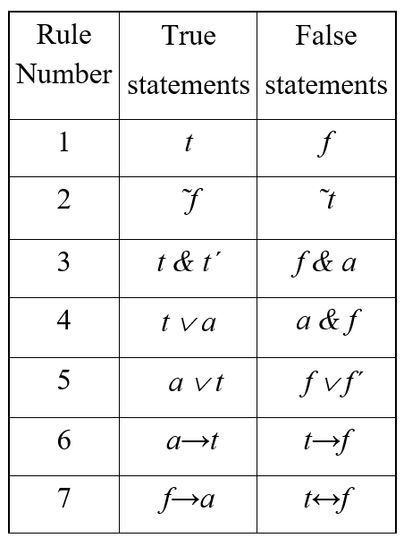
Rule
Verify

Slide 17
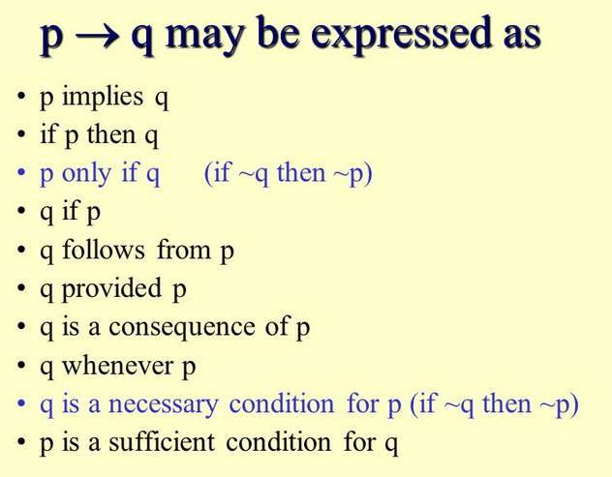
p→q

Slide 18

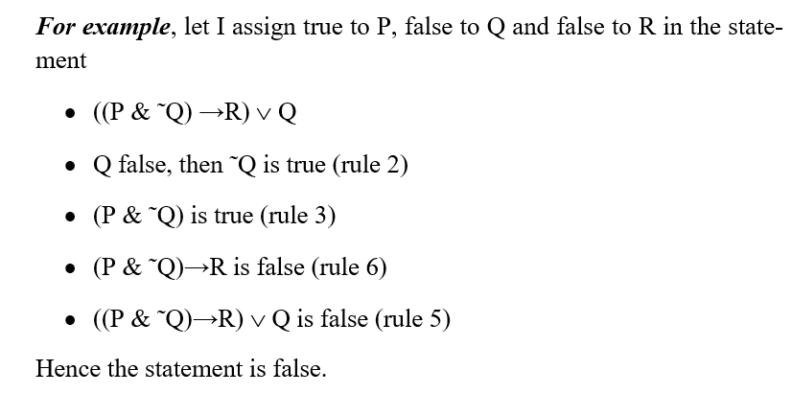
Continue

Slide 19
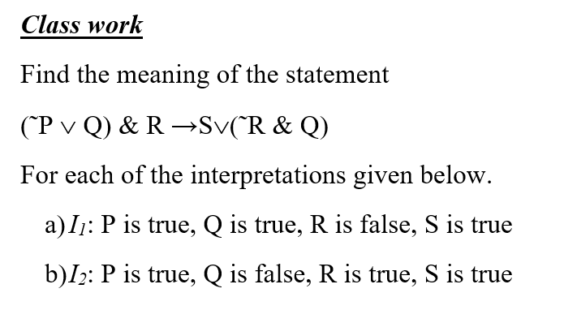
Continue

Slide 20
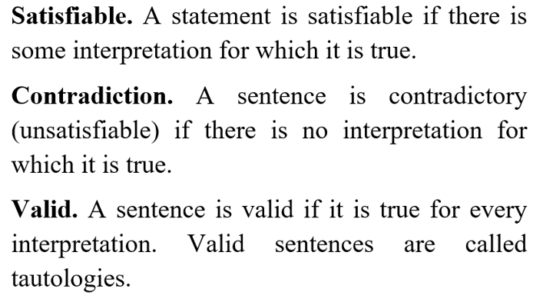
Properties of Statements

Slide 21
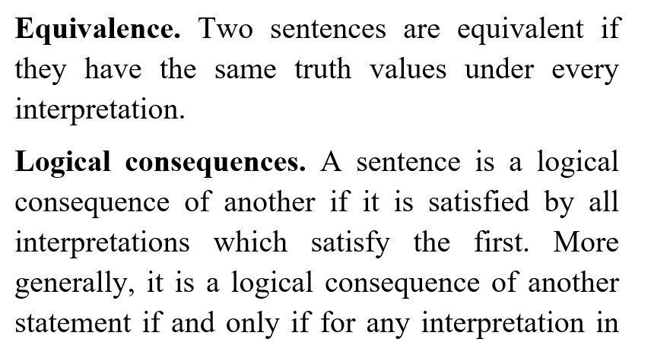

Properties of Statements

Slide 22
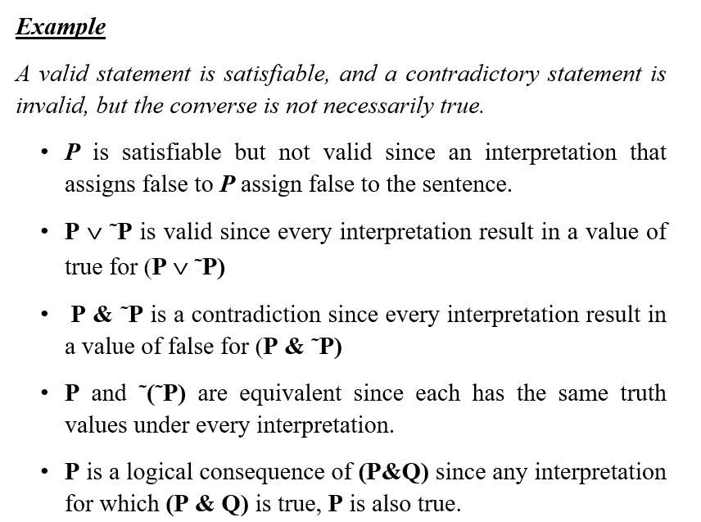
Properties of Statements
Put in the slide

Slide 23
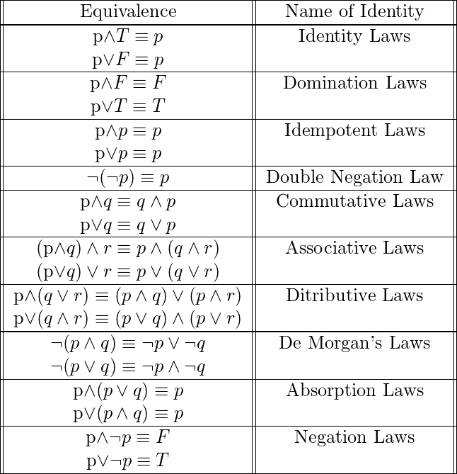
Equivalence laws

Slide 24
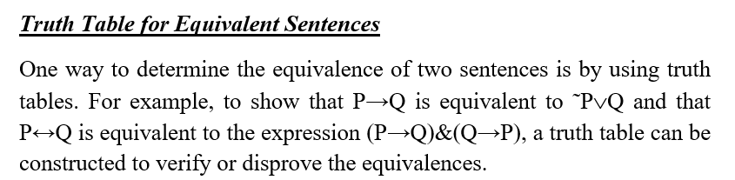
Truth Table

Slide 25
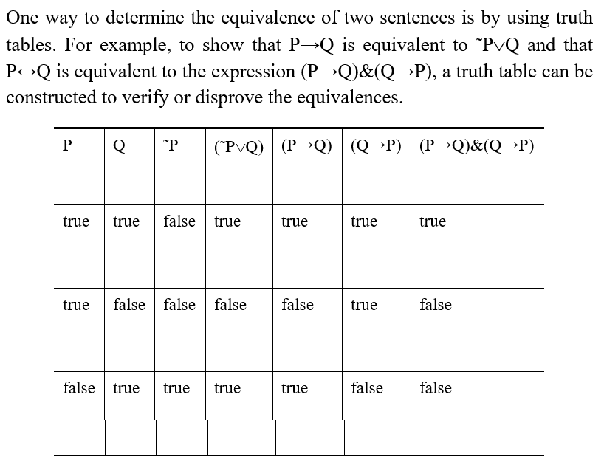
Truth Table (Verify)

Slide 26
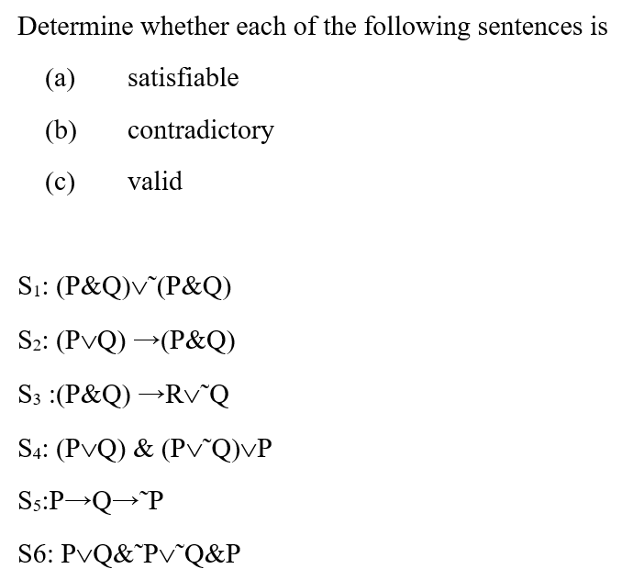
Class Work

Slide 27
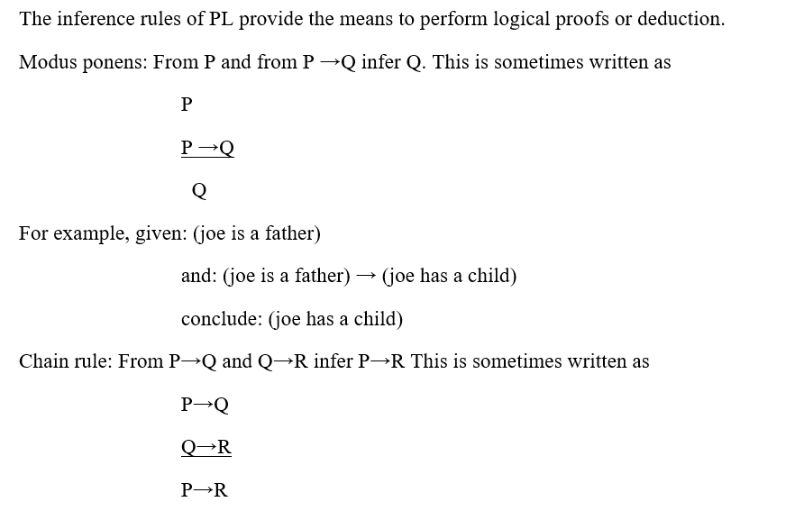
Interference rule

Slide 28
Interference rule

Slide 29
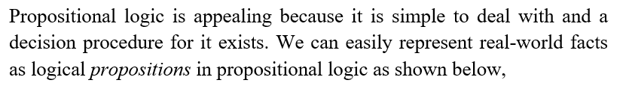
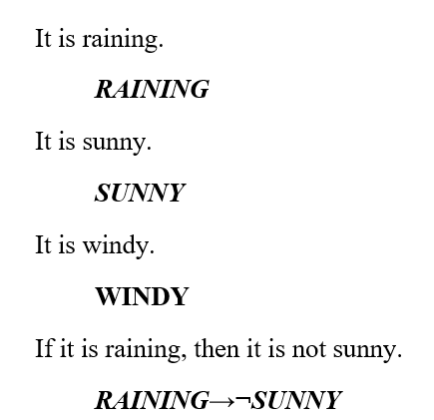
Representing Simple Facts in Logic

Slide 30

Representing Simple Facts in Logic

Slide 31
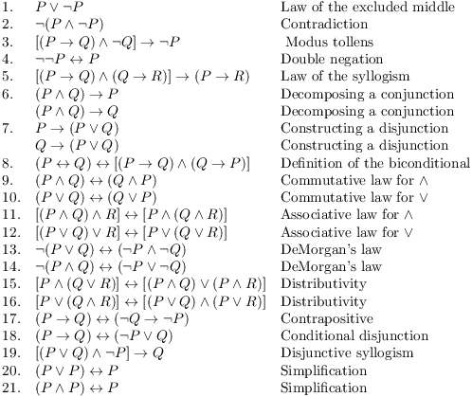
Equivalence laws

Slide 32
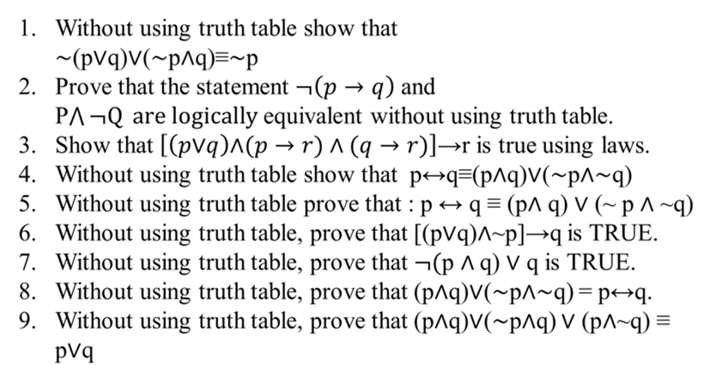
Home work

